Slide 1


Created by: Arthur Levitsky

Slide 2


The purpose of this website was to create a Q&A (Question and Answer) website designed for Montclair State University students that major in CSIT.
The website allows students to exchange questions and answers regarding specific CSIT courses at Montclair State University.

Slide 3




The technology that this website utilized is primarily HTML, CSS for the design of the website.
The server-side scripting language used is PHP that was used to connect with MYSQL database.
The website was completely created from scratch, no frameworks or libraries used.

Slide 4
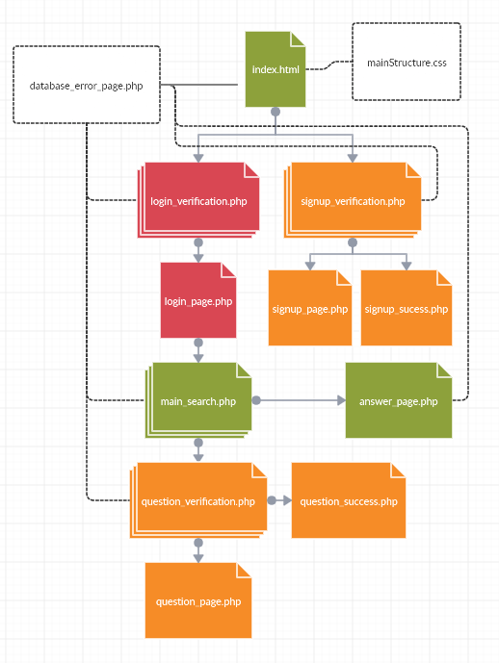
mainStructure.css is utilized by all the pages for the website. The purpose is to reuse repeating design elements.
database_error_page.php is using 5 .php pages for the website as they are used to get or post information to the MYSQL database.

Slide 5
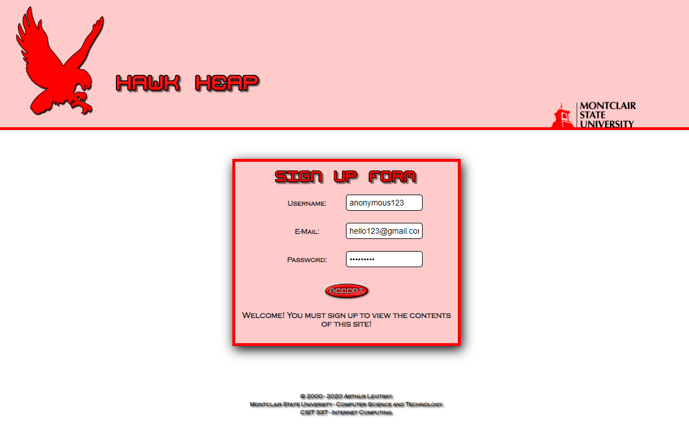

Slide 6
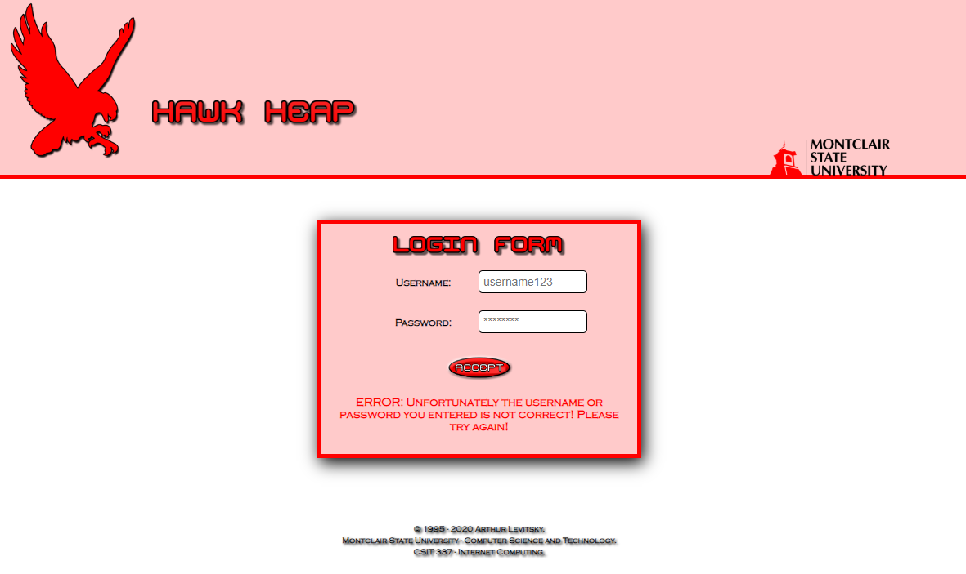

Slide 7
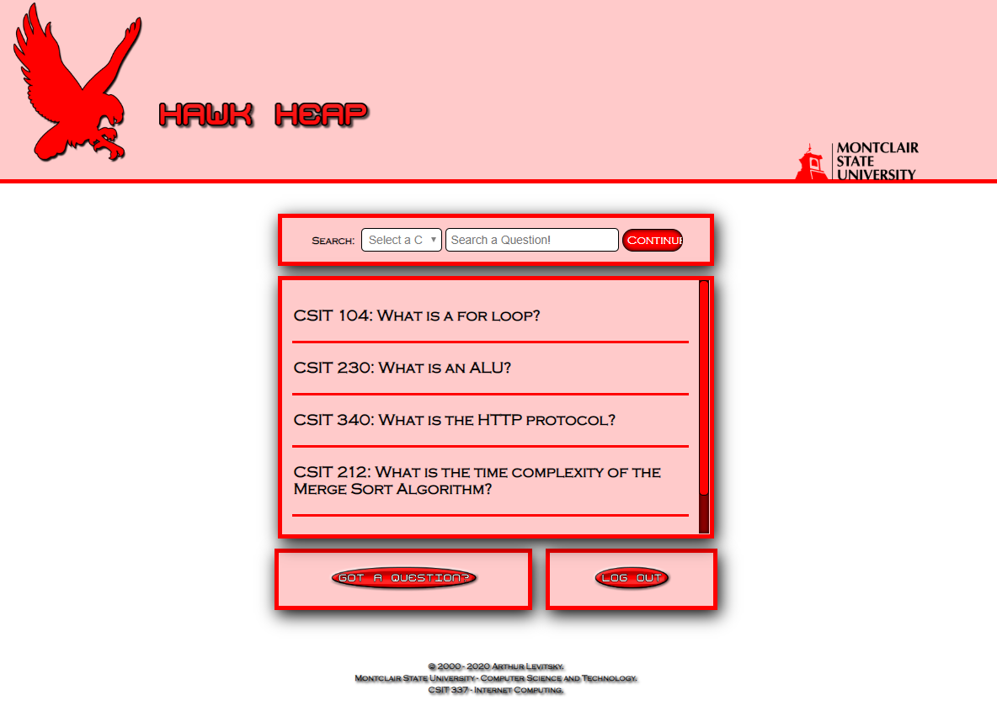

Slide 8
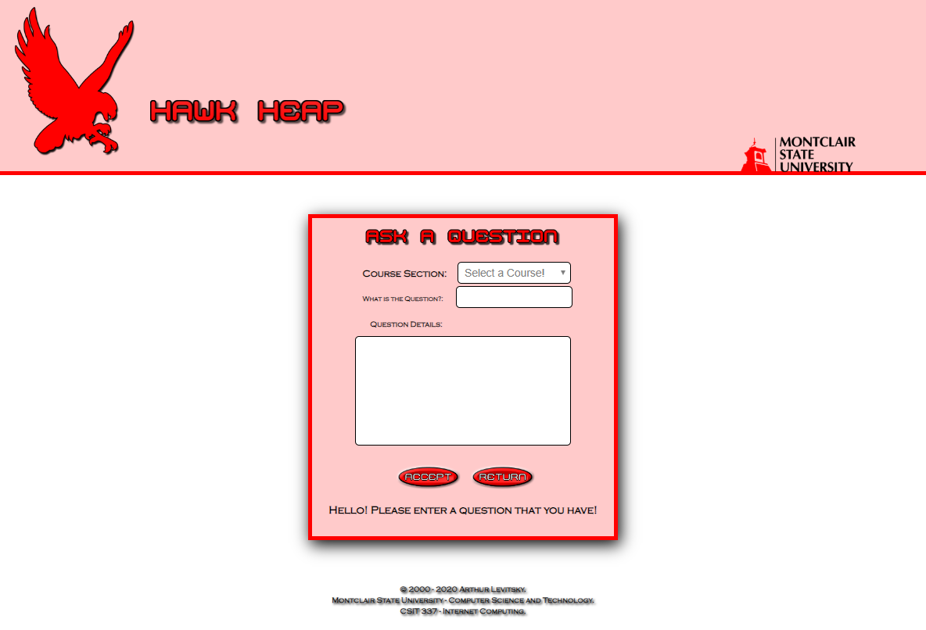

Slide 9
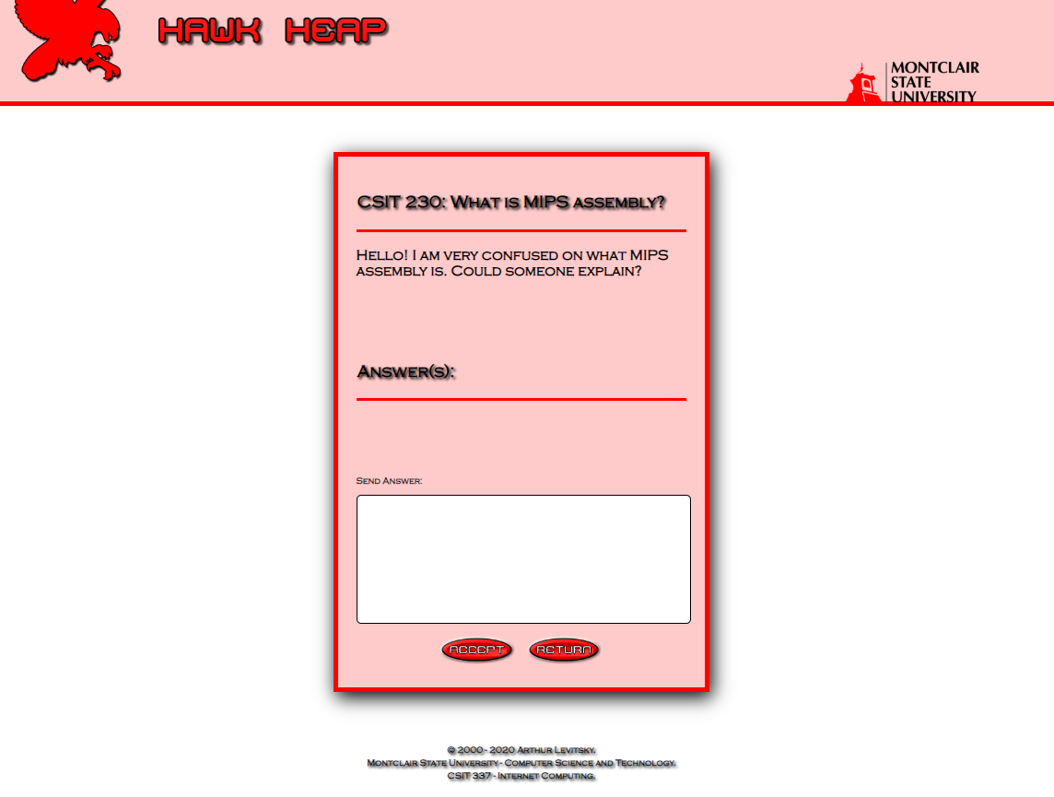

Slide 10

Some of the features that were missed was the voting system for the answers in the question.
Adding timestamps for when the question was posted and by which logged in user would have been an interesting thing to do. This could have also been implemented for the answers as well.
The ability to edit the question after posting it.

Slide 11

One of the biggest improvements to my website would be to engineer the scripts that I have written out. For the majority of those scripts, they held a lot of code in it that could use a bit of revisioning. Of course they work but that doesn’t necessarily mean that it’s efficient.
The possibility of using Javascript instead of using php for some webpages would have been more efficient. PHP, although dynamic as well, isn’t meant to be used for visual aspects rather for transferring or obtaining data from a database.
No encryption was added to the passwords that were implemented. This is very important for a real website.
Leaning into measures to protect against SQL injections.

